Slide 1
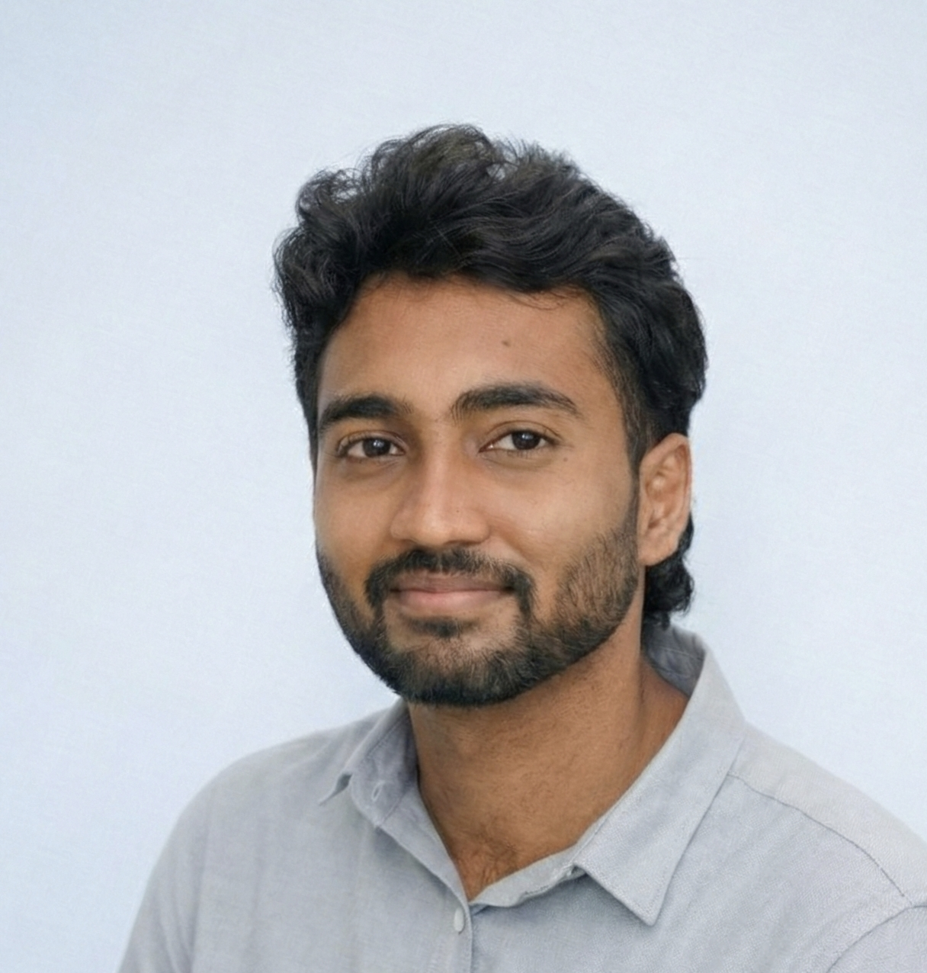
RESUME
HARI PRASANTH K
B.Tech-Artificial Intelligence and Data Science +91 6380 588 400
Email : yash2hari@gmail.com
Linkedin: https://www.linkedin.com/in/hari-prasanth-867916290
GitHub: https://github.com/Heisenberg-hari
Objective:
Data Science student skilled in Python and MySQL for data cleaning, analysis, and reporting. Experienced in handling datasets using Pandas and NumPy and presenting insights through Matplotlib and Seaborn. Seeking an entry-level opportunity to support data-driven decision-making.
Education:
Under-graduate | B. Tech – Artificial Intelligence and Data Science | 2023 - 27 Kumaraguru Institutions, Coimbatore – 7.59 CGPA(till 5th)
HSE | Mathematics & Computer Science | 2021 – 23
Government Higher Secondary School, Muthur– 92.16%
Soft Skills:
Quick Learning
Analytical thinking
•Effective communication
Team collaboration
•Leadership
Techinical Skills:
•• Programming Languages: Python, R , SQL
• Frameworks & Libraries: Tensorflow, PyTorch , Numpy, Pandas, Sklearn
• Tools & Visualization: Power BI, Tableau, Seaborn, Matplotlib
• Developer Tools: Git, Github

Slide 2
Projects
Crop Yield Prediction Using Time Series | GITHUB
Tech Stack: Python, Pandas, NumPy, Scikit-learn, Matplotlib, Seaborn
Techniques: Time Series Forecasting, Regression, Feature Engineering
Built predictive models to forecast future crop yield using meteorological and historical crop data.
Applied time series and machine learning techniques for accurate yield estimation.
Focused on edible and medicinal crops to support data-driven agricultural planning.
CIFPD-Based Software Defect Prediction Framework | GITHUB
Designed a CIFPD framework for intelligent feature prioritization and software defect detection.
Combined statistical feature selection, RoBERTa embeddings, XGBoost classification and SHAP explainability.
Certification:
1.Google AI/ML Virtual Internship (Eduskills)
2.Data Visualization by University of Illinois Urbana-Champaign (Coursera)
3. Power BI Business Scenarios with Hands on Use Cases (Udemy)
Internship / Research:
Junior Software Developer Intern – BINI
.
Personel Interest
Data analysis and visualization
Machine learning model
experimentation
Research oriented problem solving
Languages Known
English
Tamil
DOB : 9 October 2005
Address : Karur,TamilNadu -639206

